Slide 1

DATA 410 – Assignment 7 Final Presentation
Kristyll Avila

Slide 2
(1) Business Understanding –High Level

Slide 3
Case Study
Optimizing the Operation to Animal Shelters to Minimize Unnecessary Euthanasia: A Case Study in the Seoul Capital Area
https://sfu-primo.hosted.exlibrisgroup.com/permalink/f/1u29dis/TN_cdi_proquest_journals_2533340302

Slide 4
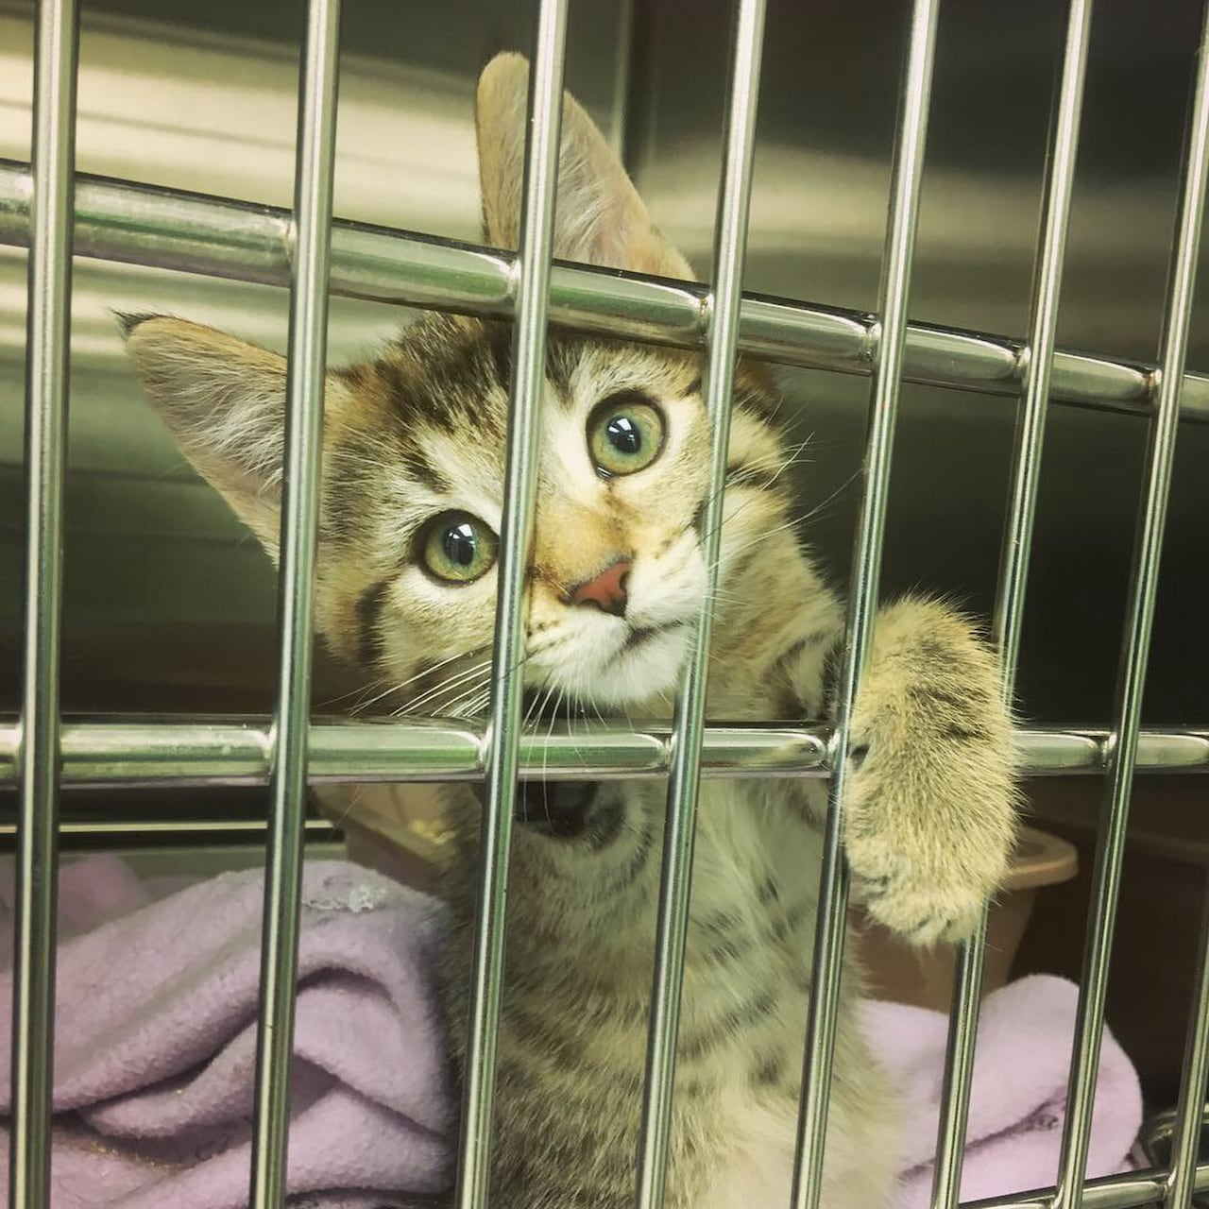
Introduction
Due to insufficient facilities, numerous animals brought to shelters are euthanized, while natural deaths occur resulting from poor shelter conditions. Moreover, the existing number of animals shelters fails to adequately accommodate the increasing influx of rescued animals under the circumstances where the adoption rate is decreasing. This case study explores for solutions based on previous shelter management model to develop a new model that optimizes shelter capacity and ensures equitable distribution of animals within various shelters.

Slide 5
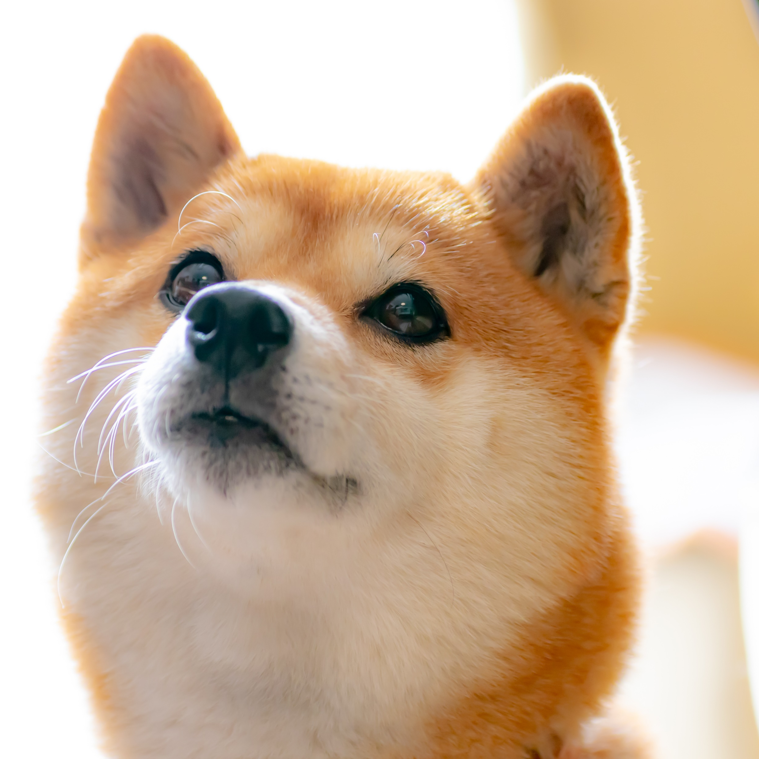
5W 1H Analysis 1 – Who
# | Question | Answer
Q1.1 | Who is involved? | Anyone considering to adopt a pet, associated to managing animal shelters, veterinarians and shelter staffs, and animals.
Q1.2 | Who is affected? | Anyone associated to managing animal shelters, veterinarians and shelter staffs, and animals.
Q1.3 | Who will benefit? | Anyone associated to managing animal shelters, veterinarians and shelter staffs, and animals.
Q1.4 | Who will be harmed? | Animals.

Slide 6
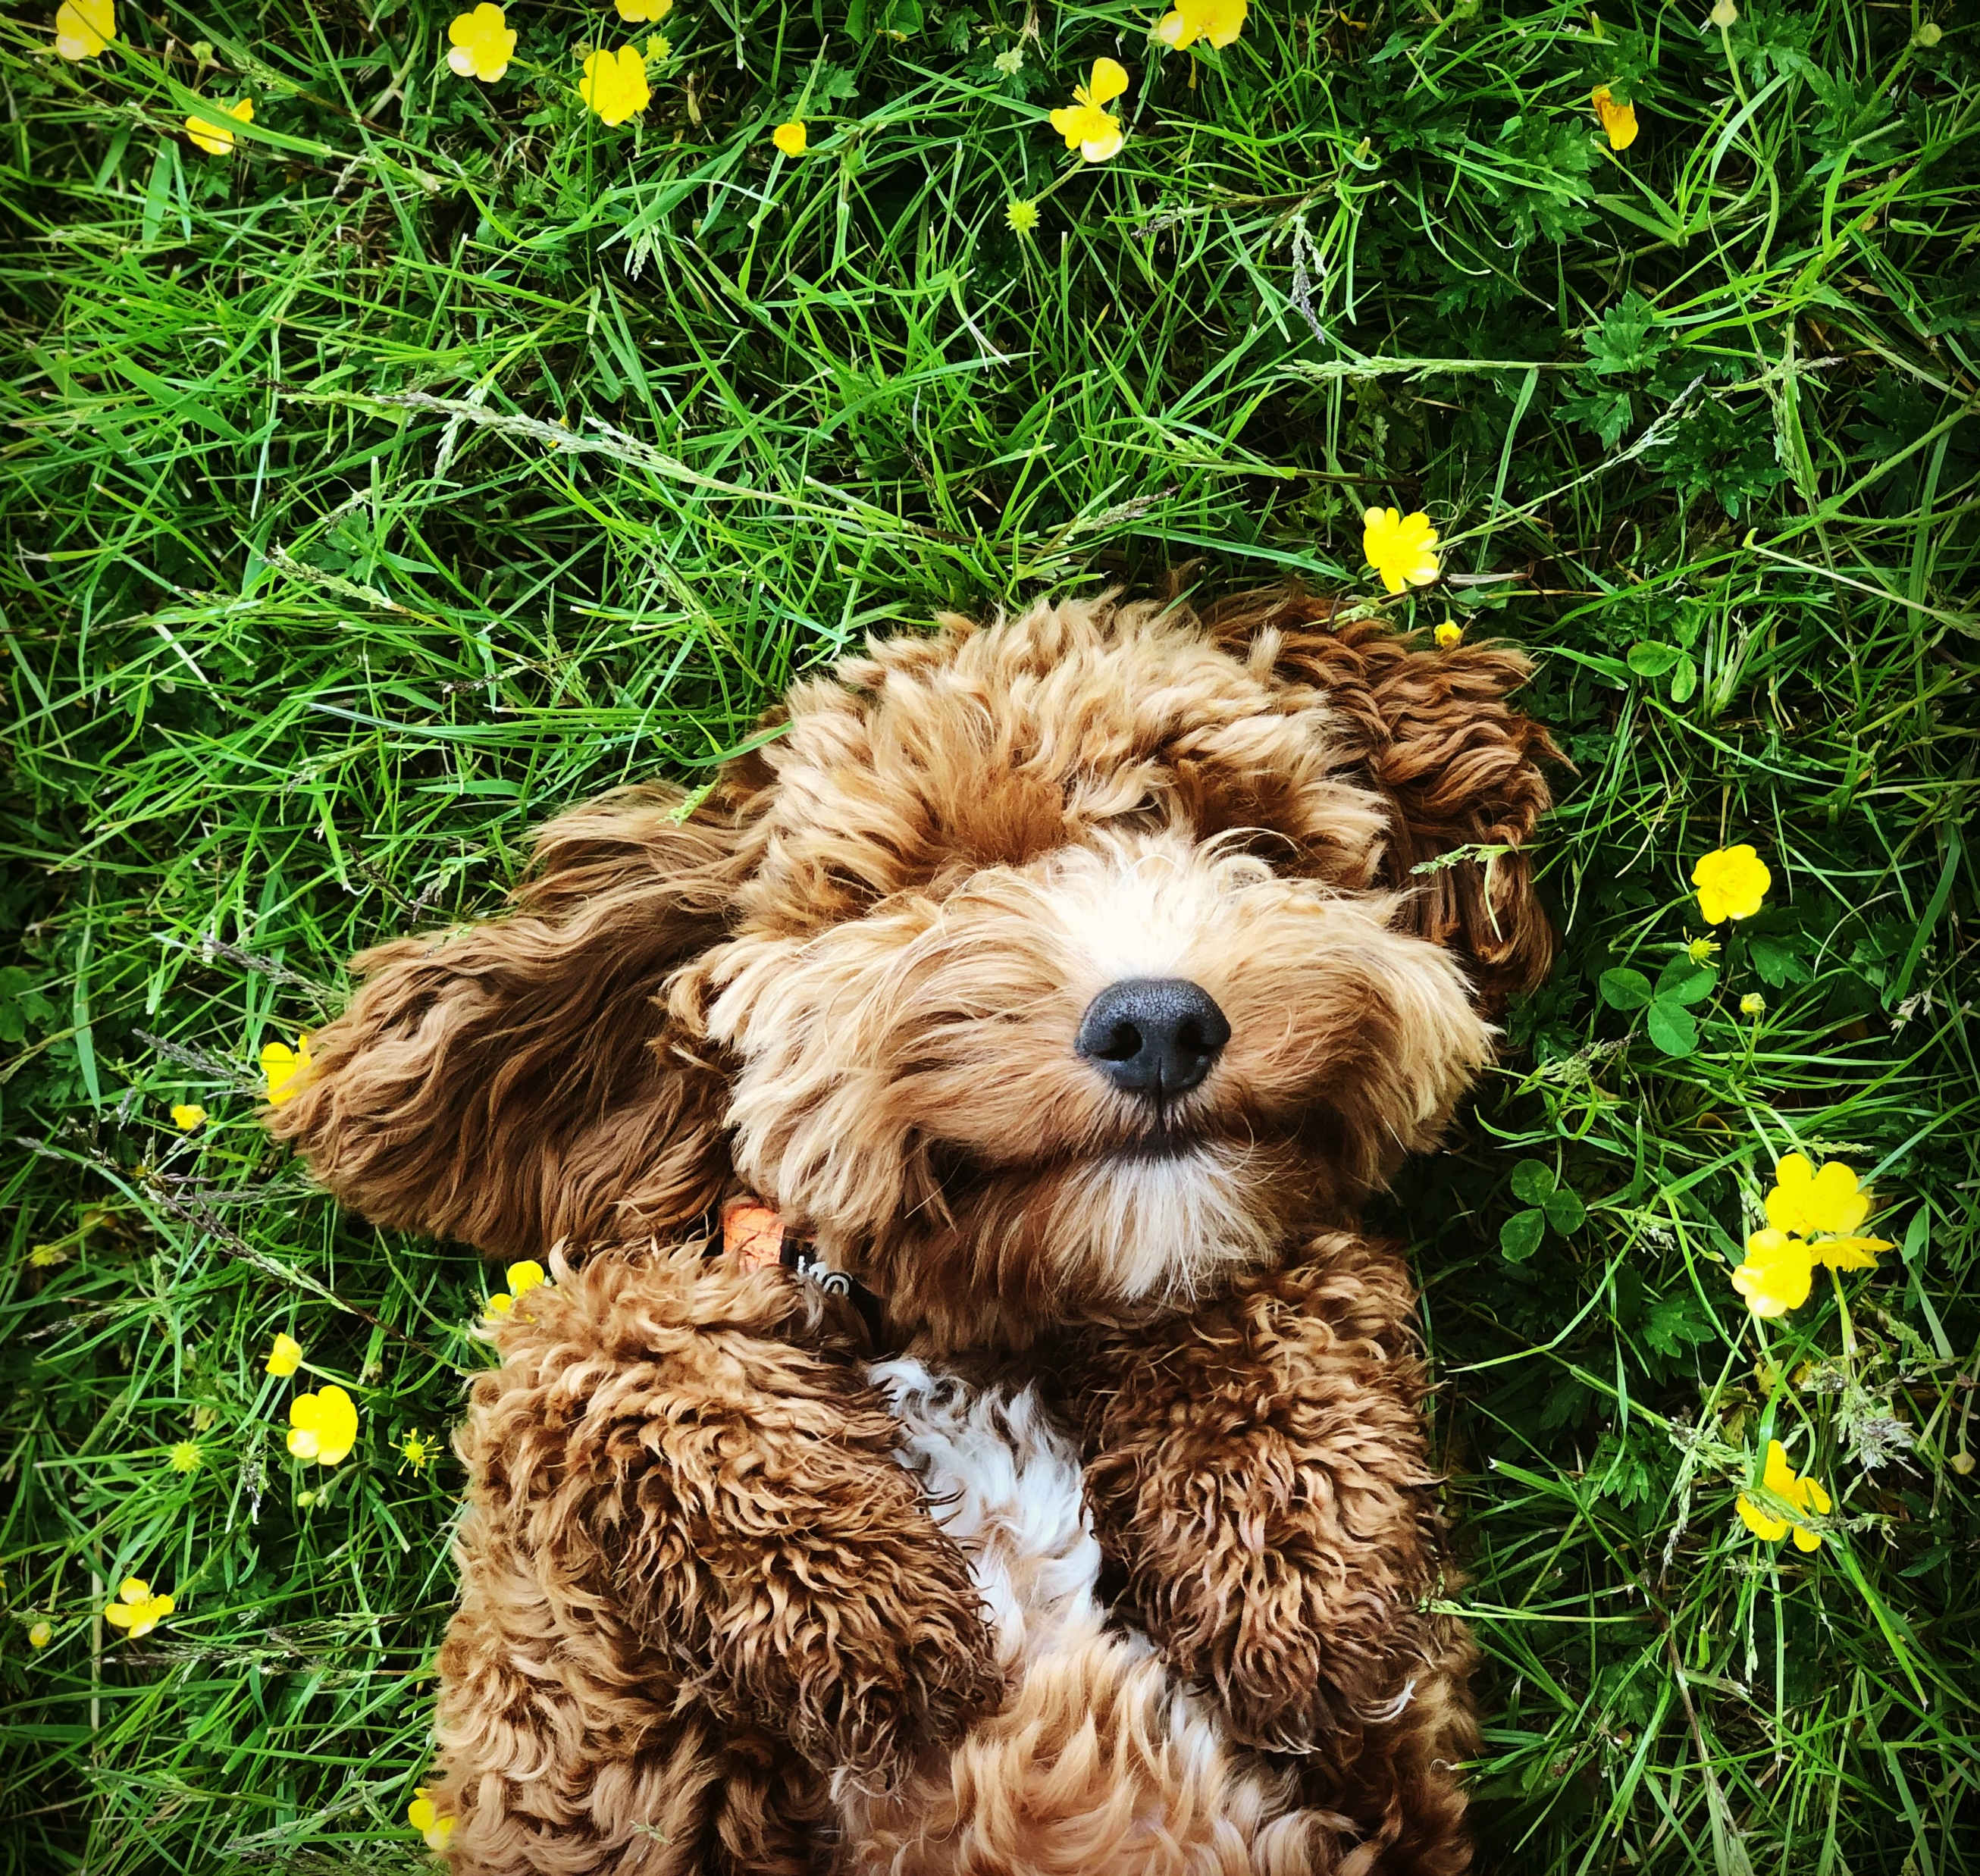
5W 1H Analysis 2 – What
# | Question | Answer
Q2.1 | What is your topic narrowed down in a simple phrase/sentence? | The insufficient number of facilities leads the animals entering the shelter to be euthanized.
Q2.2 | What does your topic involve? (i.e. What are the different parts to it?) | The infrastructure for the animal shelters cannot be expanded Minimum budget Low adoption rate High expenses for animal care
Q2.3 | What is it similar to / different from? | This case study has the same nature as wildlife rehabilitation centers in terms of managing available capacity and intake of rescued animals. The case study is different from marine conservation organization which works to protect and preserve marine ecosystems and the diverse species that inhabit them.
Q2.4 | What might be affected/changed by your topic? | The situation can be changed dependent on public interest in animal welfare. Optimizing available capacity and enabling equitable distribution of animals within various shelters. Perception towards companion animals Increase media promotion Policy measures

Slide 7
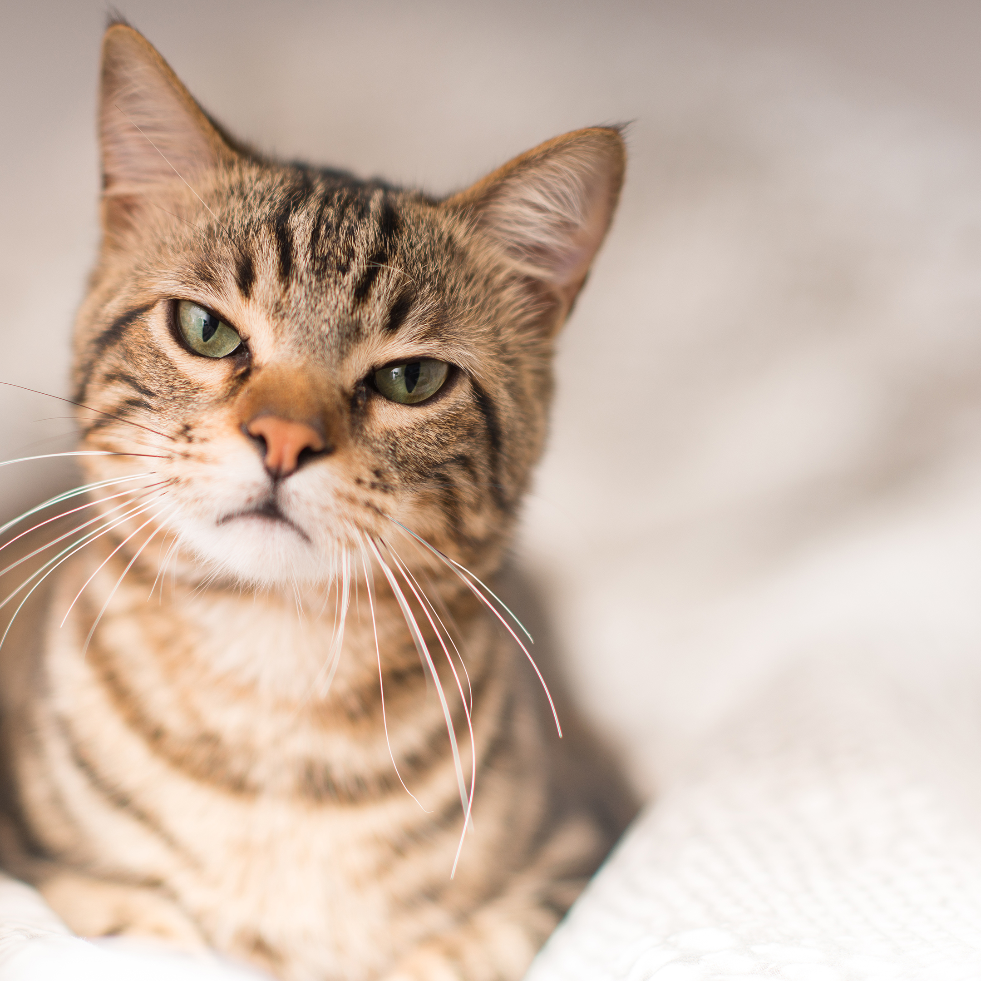
5W 1H Analysis 3 –When
# | Question | Answer
Q3.1 | When does this take place? When did this take place? When will it take place? When should this take place? | Euthanization is inevitable once shelter is not able to operate and accommodate in a level to meet the animal’s basic needs. Overcrowding Minimum budget
Q3.2 | Does when this takes place affect the topic? | Yes, the timing can vary depending when shelters may eventually receive more funding, if people decides to adopt, facility expansion, etc.

Slide 8

5W 1H Analysis 4 – Where
# | Question | Answer
Q4.1 | Where does this take place? (Where did it …. Where will it … Where should it ….?) | Euthanization can happen everywhere and anywhere.
Q4.2 | Does it matter where it takes place? Is it affected by location? | Yes, there are different laws and policies that can restrict abandonment of animals which is regulated under an Animal Protection Act or Criminal Code.

Slide 9
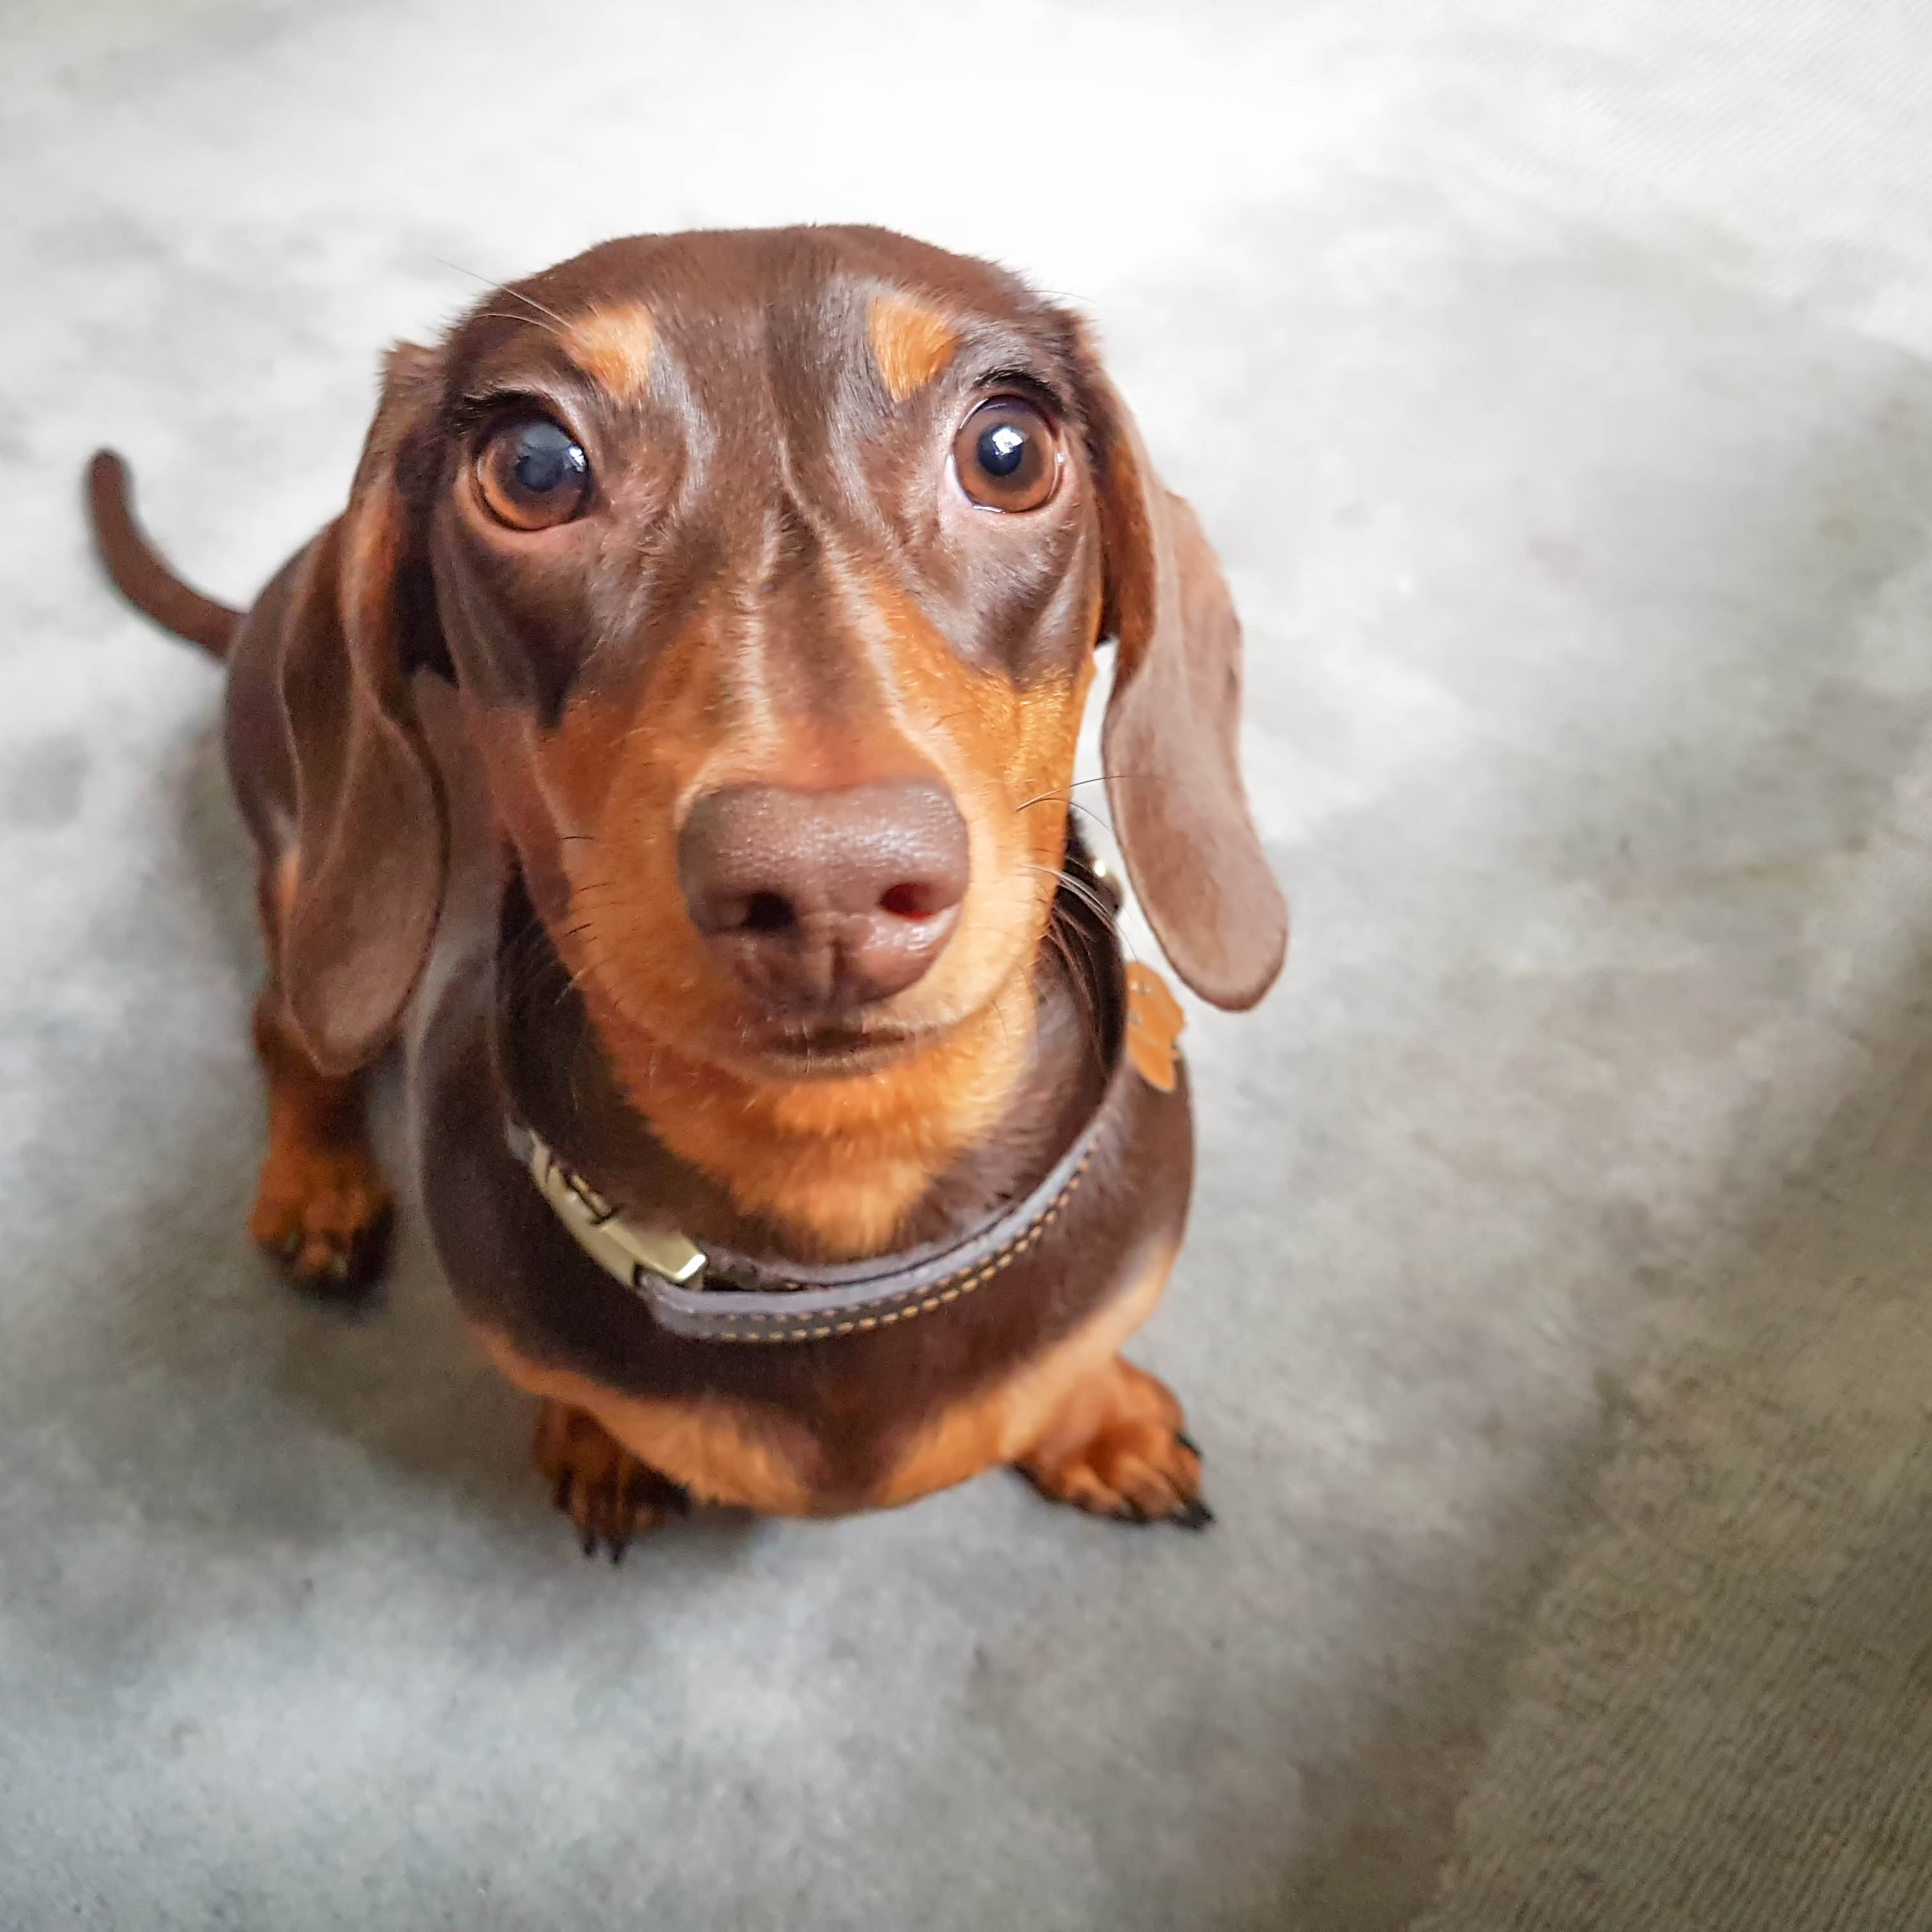
5W 1H Analysis 5 – Why
# | Question | Answer
Q5.1 | Why is this topic important? Why does it matter? | “In a sustainable society, animal welfare, as well as human well-being, can become sustainability measures because we can judge how mature society is from its attitude toward animals that are weaker than humans”
Q5.2 | Why do certain things happen? (What are some causes and effects within the topic?) | Increased intake of rescued animals within animal shelters. Abandonment Financial Stability Overbreeding

Slide 10
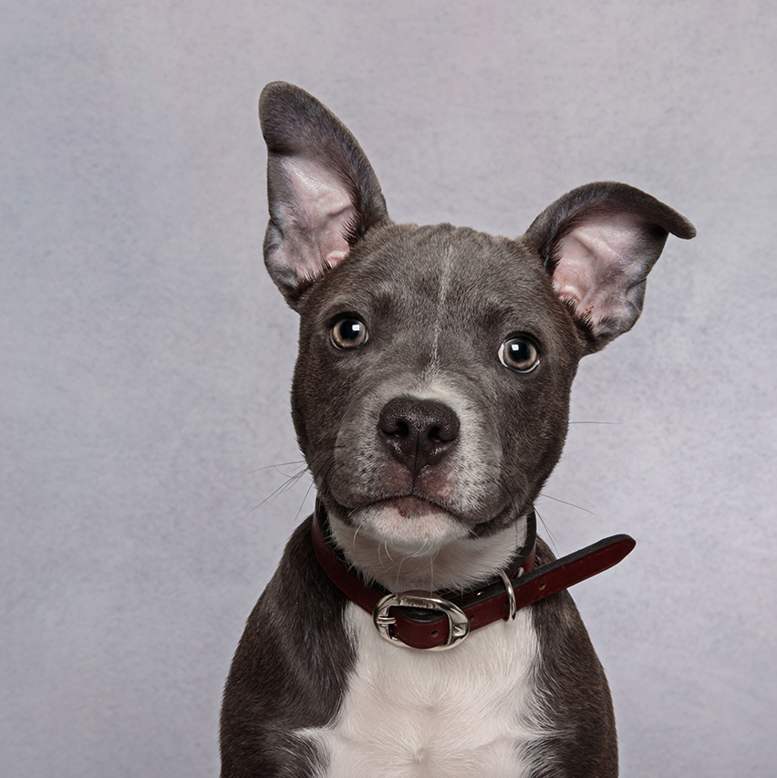
5W 1H Analysis 6 – How
# | Question | Answer
Q6.1 | How does this topic work? How does it function? How does it do what it does? | A certain level of euthanasia is inevitable for each shelter to operate the facility within the limited budget. Unavoidable euthanization of animals that do not have health problems should be minimized to promote welfare.
Q6.2 | How did it come to be? | Unexpected increase of influx of rescued animals where shelter are unable to accommodate due to lack of capacity and budget to care for the animals.
Q6.3 | How are those involved affected? | There are negative effects instilled in animals such as stress due to transfers and conditions within shelters. In addition, the negative effects due to mental stress from animal euthanasia experiences by veterinarians and shelter staff in charge of euthanasia.

Slide 11
(2) Data Understanding – High Level

Slide 12
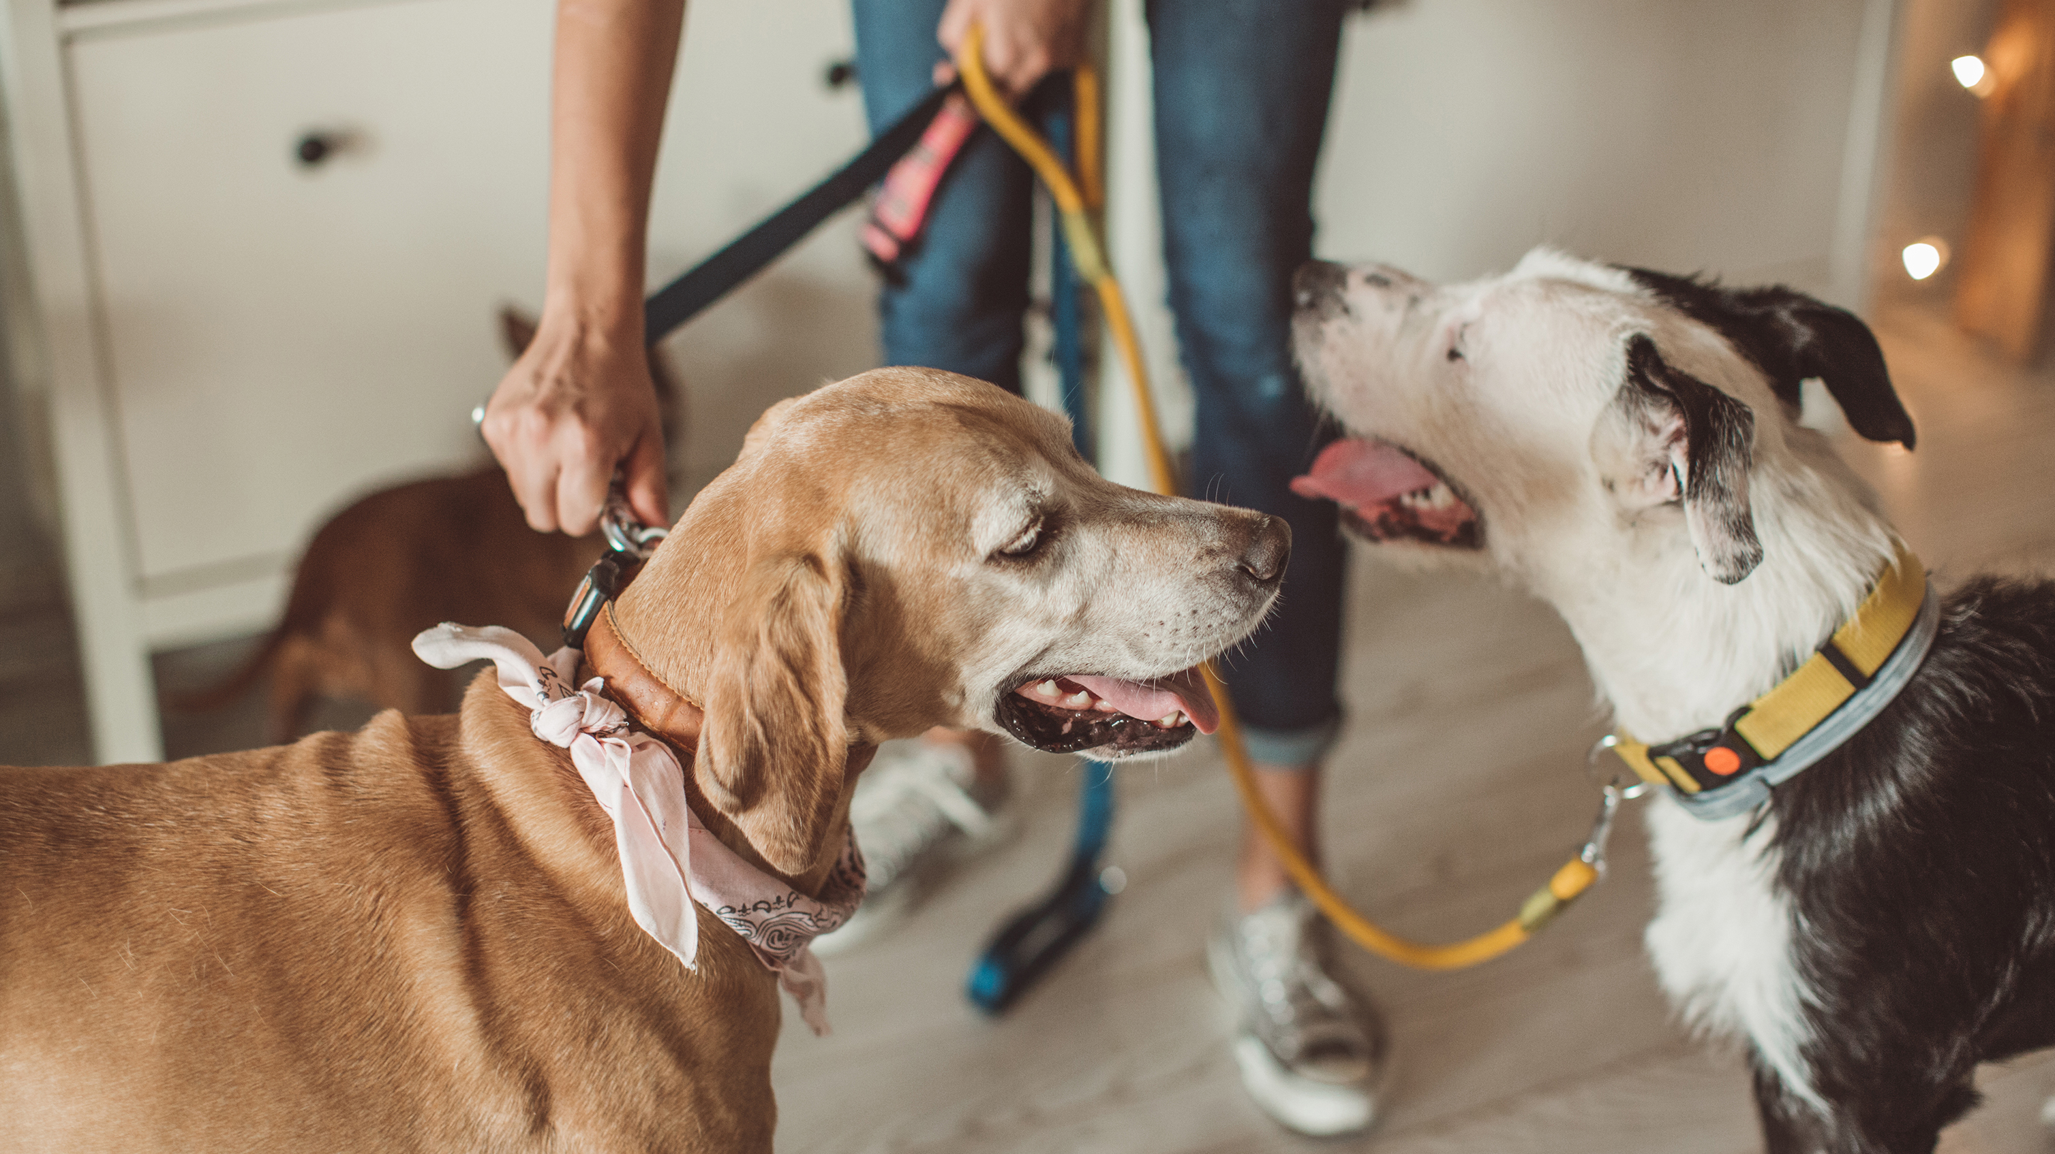

Data Modeling – Conceptual Model
INTAKE TYPE
Abandoned
Euthanasia Request
Owner Surrender
Public Assist
Stray
Wildlife
EUTHANASIA
Overcrowding
Lack of Budget
Infections
SHELTER MANAGEMENT
Adoption Rate
Budget
Volunteers
Veterinarians
Donations
Facilities
FUNDAMENTAL ISSUE
Financial Instability
Relocation
Overbreeding
Behaviour Issues
Allergies
Lifestyle Changes
Lack of Awareness
MARKETING
Social Media Promotion
Positive Perception of Companion Animals
SHELTER MANAGEMENT MODEL
Optimizing Capacity Model
Capacity for Care (C4C)
Logistic Regression Model
Free Adoption Strategy

Slide 13
Data Dictionary
No | Topic | Definition
1 | Capacity for Care (CFC) | Calculates the optimal daily population in the shelter based on meeting the shelter’s goals of anticipated adoptions and improved animal housing.
2 | Euthanasia | Intentionally ending the life of a living being.
3 | Free Adoption Strategy | Free adoption promotions during times of overcrowding can help animal shelters.
4 | Logistic Regression Model | Predicting the conditional probability of adoption from variables such as age, gender, coat colour, and reasons for relinquishment.
5 | Optimizing Capacity Model | The shelter animals are redistributed from overcrowded shelters to less crowded shelters.

Slide 14
(1 (Revisited)) Business Understanding – Low Level

Slide 15
Business Questions
Question 1)
What was the common breed being taken in and what was the intake type it is associated with?
Question 2)
How much occurrence of euthanasia was done the past 5 years?
Notes:
American Bulldog Mix, American Pitbull Terrier Mix, American Pitbull Terrier Mix, Alaskan Husky Mix, Alaskan Husky

Slide 16
(2 (Revisited)) Data Understanding – Low Level

Slide 17
Data Set(s)
Austin_Animal_Center_Intakes.csv
Austin_Animal_Center_Outcomes.csv

Slide 18
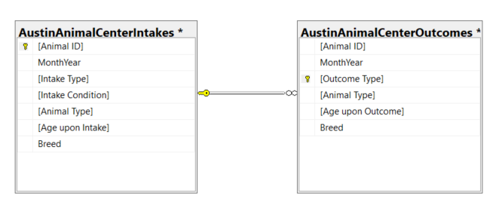
Database Diagram – Tables and Columns
Notes:
Load the Data Set into SQL Server.
Use the SQL Server Management Studio (SSMS) Diagramming tool to produce the Database Diagram.

Slide 19
(3) Data Preparation

Slide 20
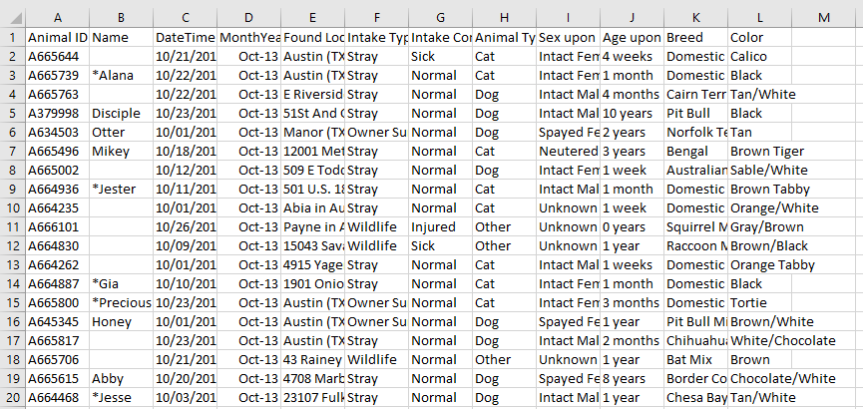
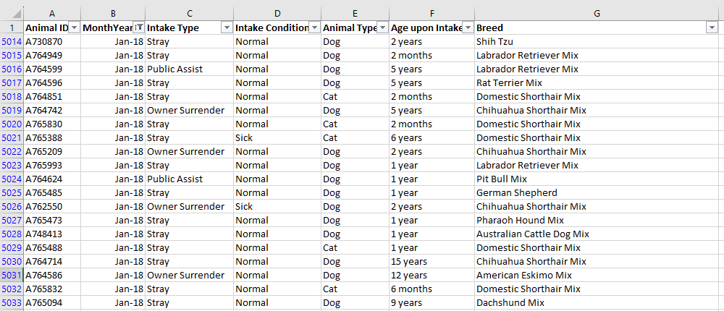
Data Preparation – Data cleansing
BEFORE
Austin_Animal_Center_Intakes.csv
Deleted Rows: 11 columns >> 7 columns
AFTER

Slide 21
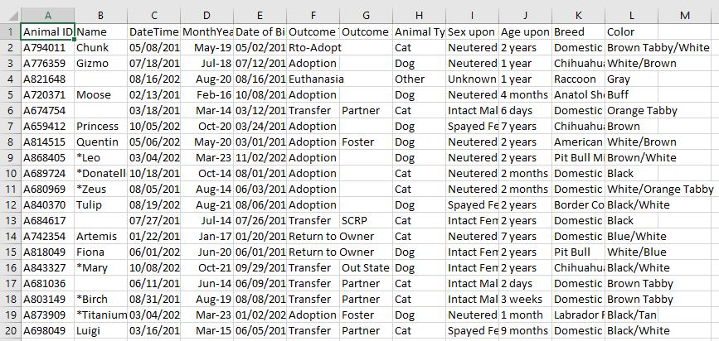
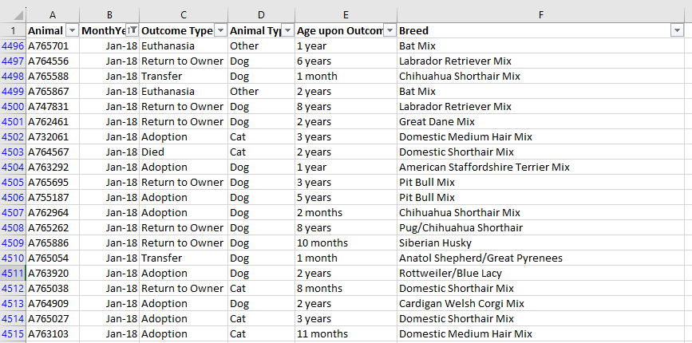
Data Preparation – Data cleansing
BEFORE
Austin_Animal_Center_Outcomes.csv
Deleted Rows: 12 columns >> 6 columns
AFTER

Slide 22
Data Preparation – SQL Query for Question 1
-- To answer question (1) about "What was the common breed being taking in and what was the intake type it is associated with?"
DECLARE @Existingdate datetime
SET @Existingdate=GETDATE()
SELECT CONVERT(varchar,@Existingdate,2) AS [YY.MM.DD], [Intake Type], [Intake Condition],[Animal Type],[Breed]
FROM [DATA410CaseStudies].[dbo].[AustinAnimalCenterIntakes]
ORDER BY [MonthYear] DESC ;

Slide 23
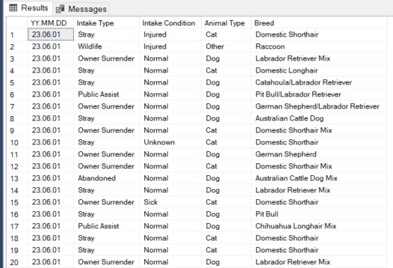
Data Preparation – Data set returned for Query 1

Slide 24
Data Preparation – SQL Query for Question 2
-- To answer question (2) about "How much occurence of euthanasia was done the past 5 years? And what age it is associated with?"
DECLARE @Existingdate datetime
SET @Existingdate=GETDATE()
SELECT CONVERT(varchar,@Existingdate,2) AS [YY.MM.DD], [Outcome Type], [Animal Type], [Age upon Outcome], [Breed]
FROM [DATA410CaseStudies].[dbo].[AustinAnimalCenterOutcomes]
ORDER BY [MonthYear] DESC ;

Slide 25
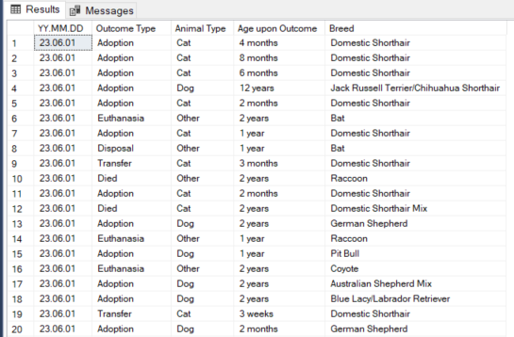
Data Preparation – Data set returned for Query 2

Slide 26
(4) Modeling

Slide 27
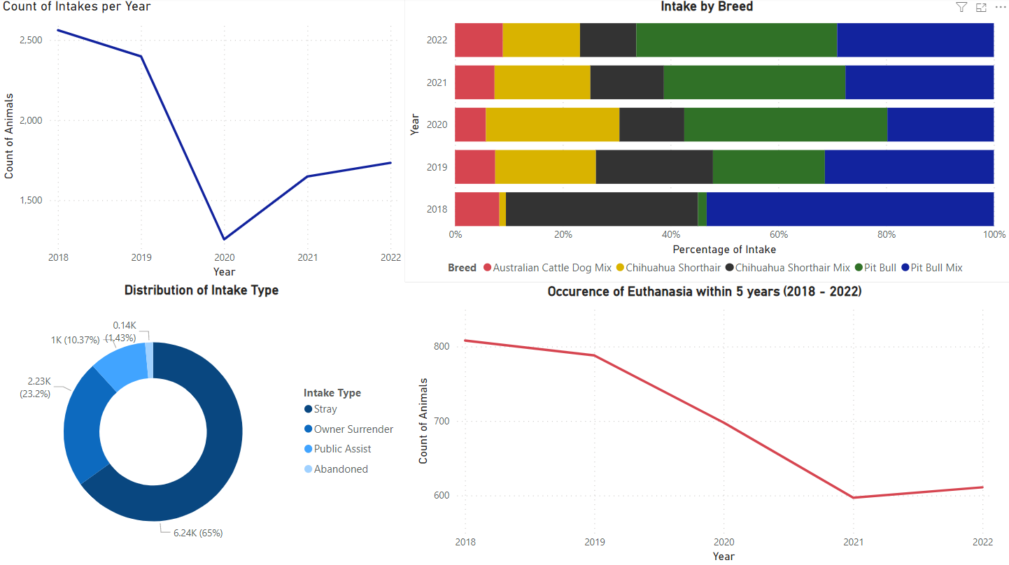
Visualization - Dashboard

Slide 28
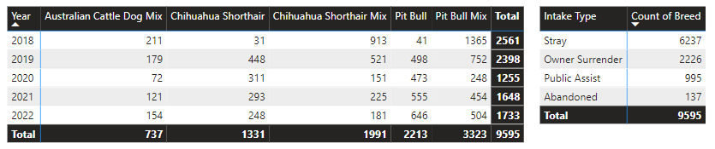
Visualization – Report 1

Slide 29
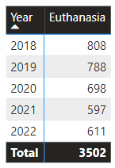
Visualization – Report 2

Slide 30
(5) Evaluation

Slide 31
Conclusion – Answer to Question 1
What was the common breed being taken in and what was the intake type it is associated with?
The most common breed taken in is a Pit Bull Mix, which are often associated with them being strays.

Slide 32
Conclusion – Answer to Question 2
How much occurrence of euthanasia was done the past 5 years?
Occurrence of euthanasia peaked in 2018 with a total of 808 deaths based on the top five breeds often taken in. Overall, there has been a significant decrease of euthanasia within the 5 years span.

Slide 33
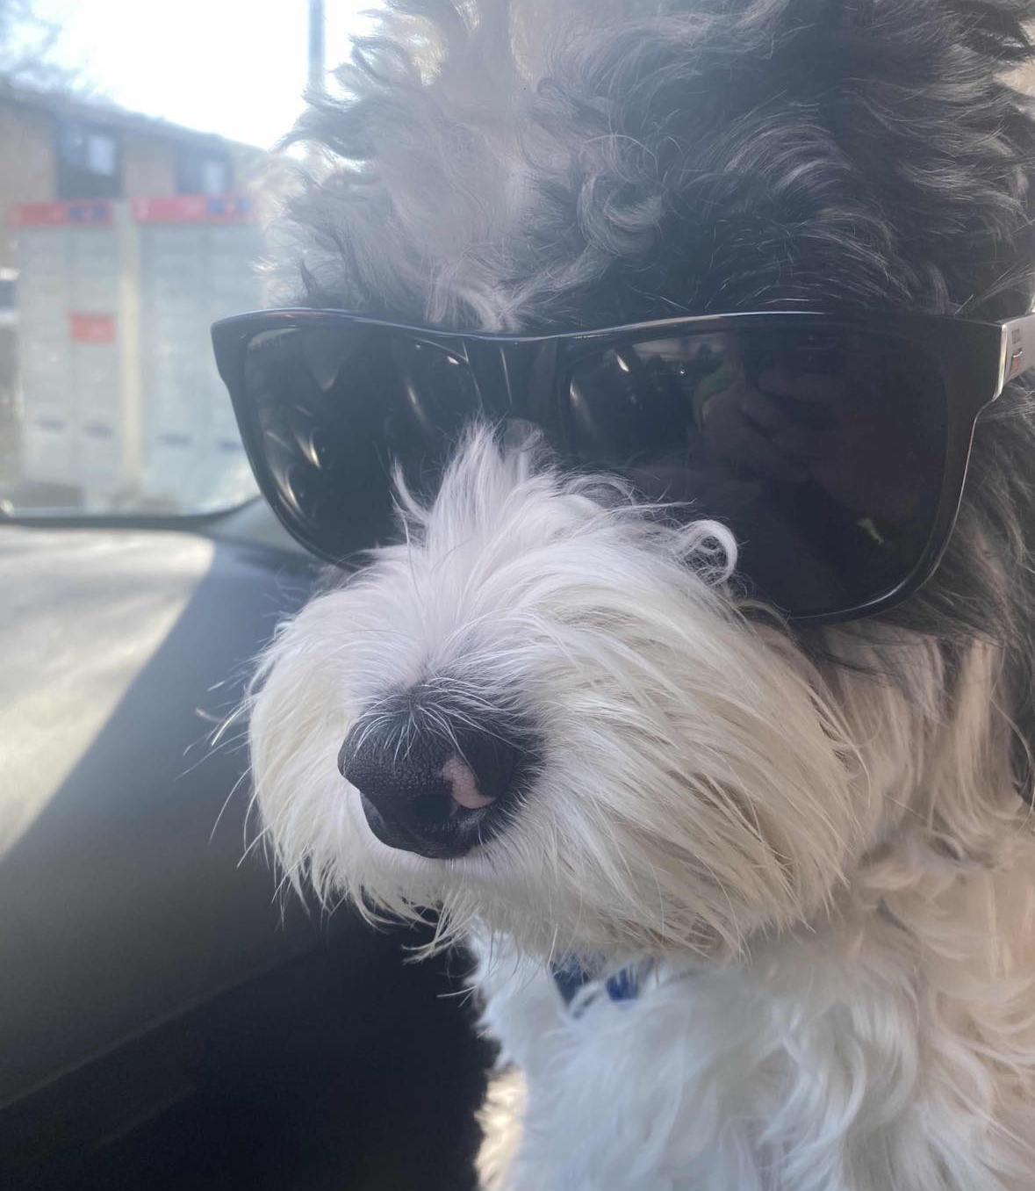
THANK YOU

